Slide 1
Angular

Slide 2
TDF Vs MDF
Easy to use
Suitable for simple scenarios and fails for complex scenarios
Two way data binding(using [(NgModel)] syntax)
Minimal component code
More flexible, but needs a lot of practice
Handles any complex scenarios
No data binding is done
More component code and less HTML markup

Slide 3
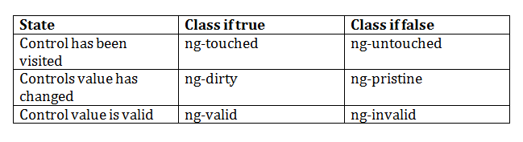
Angular pre-defined validation classes
componentRefName.errors.required
componentRefName.errors.minlength
componentRefName.errors.pattern
componentRefName.errors.maxlength

Slide 4
ngForm with ngModel with Validation
<form #formObj="ngForm“ (ngSubmit)="verify(formObj.value)“ nonvalidate>
<input type="text" name="user" ngModel required #userRef="ngModel” minlength="2"/>
<div *ngIf="userRef.errors && (userRef.dirty || userRef.touched)">
<span [hidden]="!userRef.errors.required">
UserName is required
</span>
<span [hidden]="!userRef.errors.minlength">
UserName must be 2 character
</span>
</div>
<input type="submit" [disabled]="!formObj.valid">

Slide 5
FormGroup and FormGroupControl
FormControl : The class is present in the "@angular/forms" package of Angular 2-10.Each component in form like textfield, radiobutton, checkbox is known as FormControl
FormGroup : The class is present in the "@angular/forms" package of Angular 2-10. It is used to represent a set of form control inside its constructor.

Slide 6
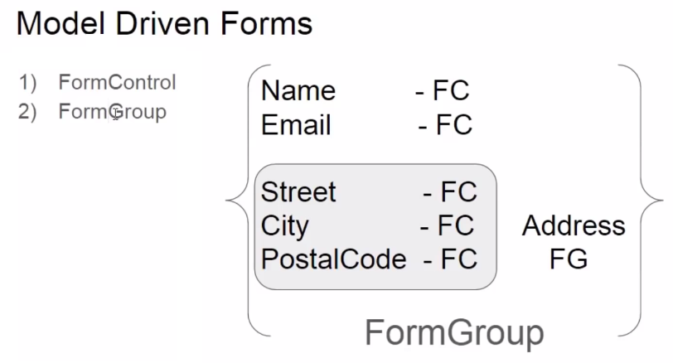

Slide 7
In Component
userForm=new FormGroup({
uname:new FormControl(),
pname:new FormControl(),
addressForm=new FormGroup({
.....
.....
})
});

Slide 8
<form [formGroup]="loginForm" (submit)="verify()" nonvalidate>
<input type="text" formControlName="user" required/>
<div *ngIf="!loginForm.controls.user?.valid && (loginForm.controls.user?.dirty
|| loginForm.controls.user?.touched)">
<div [hidden]="!loginForm.controls.user.errors.required">
UserName is required
</div>
<div [hidden]="!loginForm.controls.user.errors.minlength">
Min Length must be 2 character
</div>
</div>
<input type="submit" value="submit" [disabled]="!loginForm.valid">

Slide 9
Angular Service
Services allow for greater separation of concerns for your application and better modularity by allowing you to extract common functionality out of component.
Service is used when a common functionality need to be provided for various modules.
Angular also comes with its own dependency injection framework for resolving dependencies, so you can have your services depend on other services through out your application, and dependency injection will resolve your dependencies for you.

Slide 10
Dependency Injection
DI is a coding pattern in which a class receives its dependencies from external sources rather than creating them itself.

Slide 11
Types of Service in Angular 2-10
User-defined service
Pre-defined service

Slide 12
Steps to create the Service
Import the injectable member
Add the @injectable Decorator
Export Service class

Slide 13
Register the Service
We can register the service in two ways
In Component
In Module

Slide 14
Angular 2-10 http service
One of the most common scenario in any application is client interacting with the server.
Http is the widely used protocol for this interaction.
One can fetch data from the server, update data, create data and delete data using HTTP protocol.
In Angular 2-10 http service return the Observable but Angular 1.x is http service return the Promise object.

Slide 15
What is promise
Promise is a one type of callback function, which represents the eventual result of an operation. You can use a promise to specify what to do when an operation eventually succeeds or fails.

Slide 16
The Promise
The Promise is an object, with two functions.
then() => Promise, please get the value from that URL.
error() => Promise, please call this function when you have a new error for me.

Slide 17
Observer pattern
The observer pattern is a software design pattern in which an object, called the subject, maintains a list of its dependents, called observers, and notifies them automatically of any state changes, usually by calling one of their methods. It is mainly used to implement distributed event handling systems.

Slide 18
Observables in Angular
You can think of an observable as an array whose items arrive asynchronously over time.
Observables help you manage asynchronous data, such as data coming from a backend service. Observables are used within Angular itself, including AngularJS event system and its http client service. To use observables, Angular uses a third-party library called Reactive Extensions (RxJS). Observables are a proposed feature for ES 2016, the next version of JavaScript.

Slide 19
The Observer
The Observer is an object, with three functions.
next() => Observable, please call this function when you have a new value for me.
error() => Observable, please call this function when you have a new error for me.
complete() => Observable, please call this function when you complete your job.

Slide 20
Observable Vs Promise
Observables
Observables handle multiple values over time.
Observable are cancellable.
Promise
Promise are only called once and will return a single value.
Promises are not cancellable.

